Slide 1

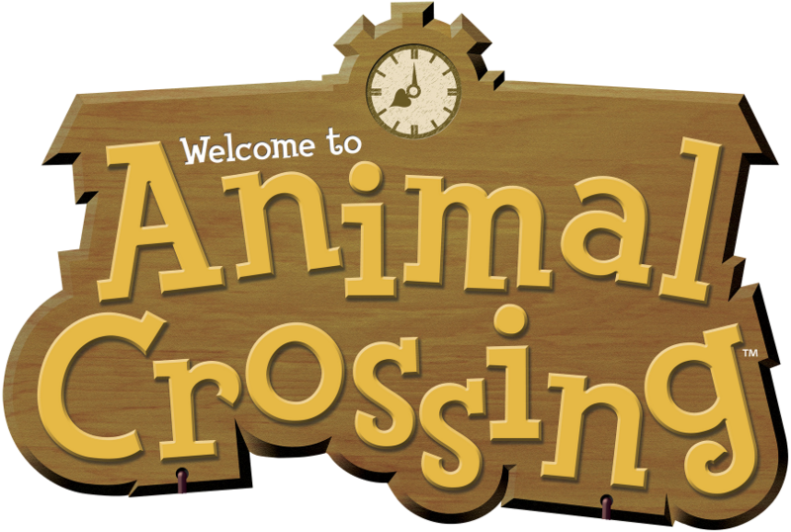
Game Analysis – Saku Karttunen
Notes:
Animal Crossing in the simplest way, is a life simulation game. It is created by Nintendo and has become one of the company’s most valued franchises. But what makes it so important? Why is it loved my so many players? What does it do to stand out so well in the sea of all of the other life sim games. I will try to answer these questions and more in this presentaion.

Slide 2

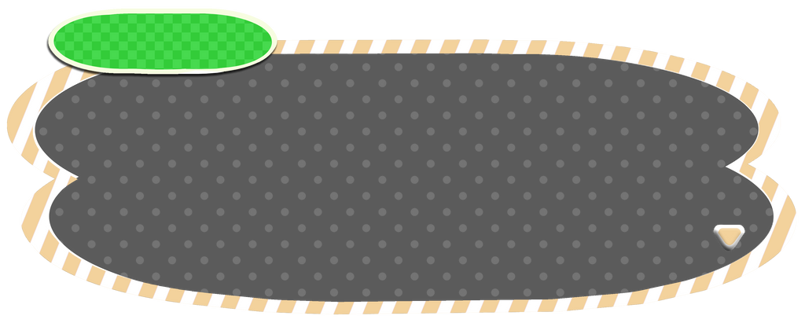
Part #1
The origin
Notes:
Animal Crossing is not a traditional game. In fact, according to this graph shown on this course, it could even not be considered a game. There is no big evil to fight, there is no clear end goal, there isn’t even any adveseries on your way. So what makes Animal Crossing such a beloved game series?
To find the answer to this question we need to get to the origin of the game’s creation.
Prior to the launch of the first Animal Crossing in 2001, there were not many games like it. A similiar game from the time of it’s creation is the original Sims, created by Will Wright. However, I would argue that even though these two games were giant influences on the life simulation genre, they tackle it from completely different angles.

Slide 3
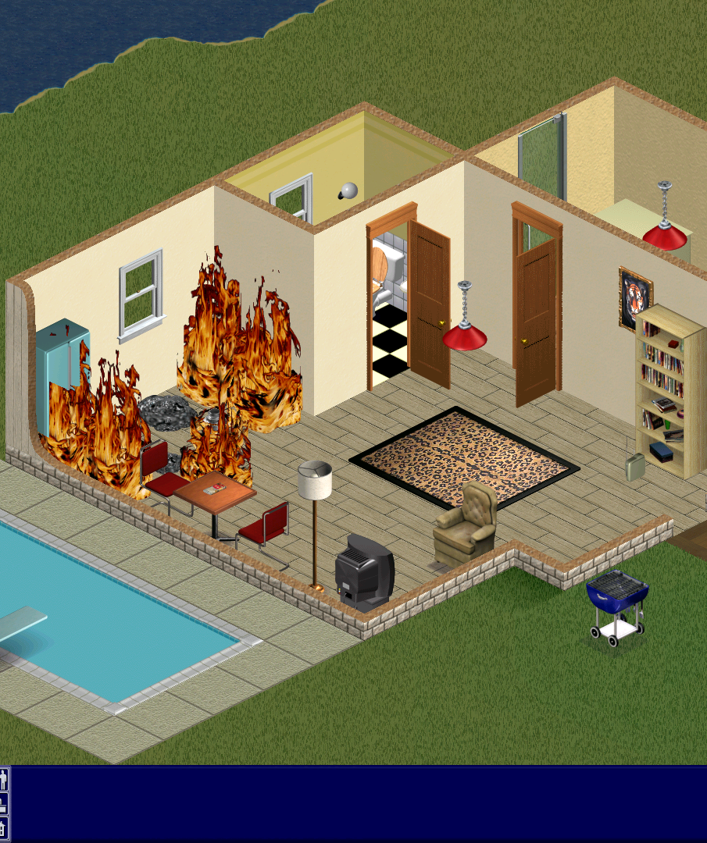
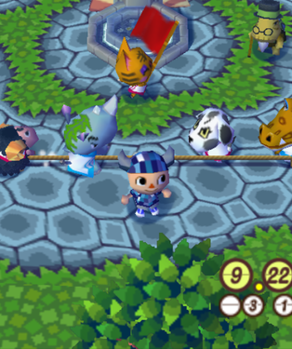
The Sims
Animal Crossing
Digital Dollhouse
Emphasis on creating your own world
Simplified interactions between characters
Feeling of creating your own virtual world
Digital village
Emphasis on character interactions
Simplified modifications to the world
Feeling of living inside a virtual world
Notes:
The Sims and Animal Crossing have many similarities, but they end up looking at the genre from very different angles.
I feel like in Sims, you feel like the creator, where you make the world your own. It focuses on giving you the tools to modify the world. The only limit being your creativity, just like if you were playing with your own dollhouse or an unorganized box of random lego blocks. The player is then given the freedom to create their own interactions and stories for the world. The gameplay interactions between the characters are then left more simplified in return. This makes the game feel more like a virtual sandbox where you create your own fun.
Animal Crossing in turn focuses more on the interactions you have with the characters of the game, referred to as the villagers. You can talk to these villagers, and they will react and answer in a manner that feels more real and meaningful. You do not have to create your own stories or character traits for these characters, since they already have distinct personalities provided by the game.
By putting the emphasis on the characters and the interactions you have with them, you do not get as much freedom when it comes to modifying the world in which you play in. For example, in the original Animal Crossing for the Gamecube and most games after it, you could only decorate your own house.
This emphasis on the characters gives the world a feeling of liveliness. Instead of having to create your own world and the stories within, the world already feels alive when you start it. It is then up to you to find out more about it. This gives the player a feeling of living inside this virtual world instead of creating your own world to live in.

Slide 4
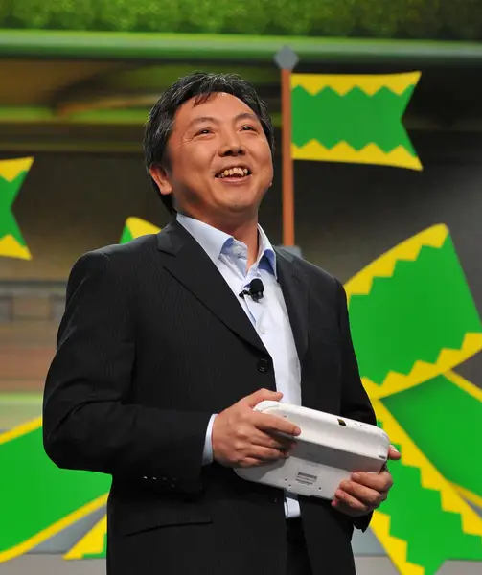
“When I moved there [Kyoto], I left my family and friends behind. In doing so, I realized that being close to them – being able to spend time with them, talk to them, play with them – was such a great, important thing. I wondered for a long time if there would be a way to recreate that feeling, and that was the impetus behind the original Animal Crossing“.
Katsuya Eguchi, recalling joining Nintendo in 1986
(National Videogame Museum, n.d.)
Notes:
The creator of the original game was a man named Katsuya Eguchi. When starting to work at Nintento in 1986 in Kyoto, he had to move a long way from his home which was in the Chiba Prefecture of Tokyo.
This move would make him miss his friends, family and home. This feeling of longing was what inspired him to create the original Animal Crossing. When recalling moving to work at Nintendo, Katsuya had this to say: [read the quote]
Source: https://animalcrossingdiaries.thenvm.org/context-history/

Slide 5

Part #2
What made it great?
Characters, Ease of play, Gameplay loop
Notes:
So how did they manage to create a hugely successful game franchise out of the feelings of belonging and community with a game that was originally designed for only 1 player?
In my opinion the 3 biggest parts of what makes the game so successful are:
The characters
The game being easy to pick up and play
And the gameplay loop that is calm, fun and keeps you coming back each day

Slide 6





Distinct personalities
The characters
Ease of playing
Requests and quests
Relaxed gameplay loop
Rewards from getting to know them
…
Notes:
The main thing that makes these characters feel interesting is their distinct personalities.
Each Villager has one of 8 personality types. This in turn makes the characters feel distinct from one another. These personality types are:
Lazy
Jock
Cranky
Smug
Normal
Peppy
Snooty
& Big sister
On top of these, all the NPC characters like shopkeepers, museum directors and mail personnel have their own personalities, these personalities make them stand out and feel alive.
On top of having distinct dialogue, the Villagers can request the player for help on some things they need to get done. This can include delivering items from one villager to another or wanting you to fetch them something like fish, bugs or fruit.
This gives you things to do, since completing these requests will reward the player with goods and rewards. Because the game rewards you from interacting with the villagers, you will start appreciating these characters more and more as you play.

Slide 7
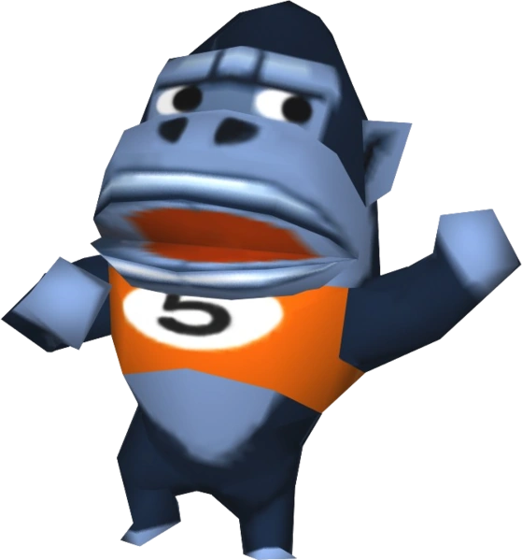
Part #3
The Gameplay

Slide 8



Real time game progression
Ease
of
play
No enemies, bosses or fighting
Do what makes you happy
Notes:
As I mentioned the game is extremely easy.
The game has a very relaxed gameplay loop. The game is running in sync with the system clock, meaning that the game has a day/night cycle matching real life. This gives the feeling of time passing even if you are not playing. You could do some tasks; quit the game and the next day you would notice that new things have happened in your village. This makes the game very easy to pick up and play, since you are not required to play in a specific way.
The game does not include any fighting. There are no enemies, bosses or a big evil that you have to handle. This makes the game fell like a calm and relaxing time off of the stresses and duties of your daily life. Because of this, the game does not require fast reflexes, prior knowledge of game mechanics or anything like that. You can just pick up the controller, start pressing buttons and move around your island. It is a great game for even those that do not play video games otherwise. Thanks to this it has been able to capture a huge audience of very casual gamers. This market is a lot larger than you might think and giving them a more relaxing and easy way to get into gaming can give huge rewards.
Lastly, the game does not tell you what to do. Instead it gives you possible things to do. Like the following.

Slide 9



Maintain the village
Things to do
Collect everything
Get to know the characters
Participate in the events
Notes:
Do you want to make your village feel more like home? You can focus on that by decorating and keeping the village neat and tidy.
Are you more interested in collecting things instead? You can do that by trying to collect each of the fish, bugs and fossils. The things you have collected can then be given to the museum, where you can see your collection grow in real time. Some collectibles are not available through the entire year though. So you will have to come back to the game at different times of the year to get all of the different fish and bugs for example.
And like I previously said, you can also get to know the characters. This will reward you with more exclusive items and rewards for keeping your villagers happy.
There also time specific events that can give you special things to do and experience. Like in the newest Animal Crossing game, New Horizons, there are multiple randomized events and calendar specific events that will give you exclusive items and boost the morale of the villagers.
As you can see, the game does not give you a specific task list on what you have to achieve in a single day. It is up to you to decide what you want to work on each day.

Slide 10
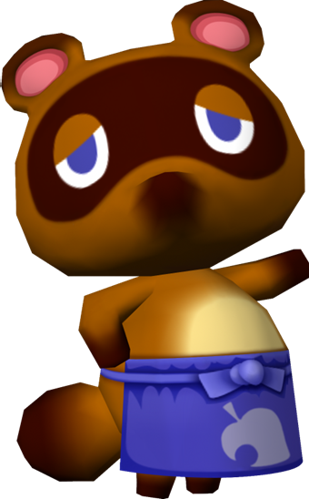
Part #4
The Success

Slide 11
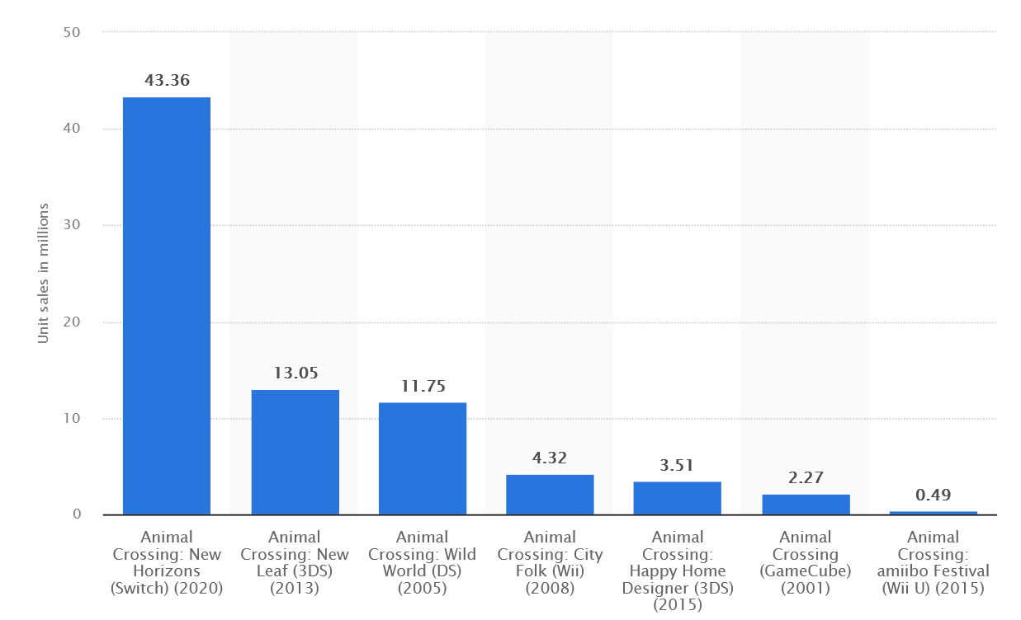
New Horizons: $60 * 43.36M $2.602B
New Leaf: $40 * 13.05M $522M
Wild World: $40 * 11.75M $470M
City Folk: $30 * 4.32M
$129.6M
HHD: $40 * 3.51M $140.4M
Animal Crossing: $50 * 2.27M $113.5M
Amiibo Festival: $50 * 0.49M $24.5M
--------------
Total: $4 Billion
Units sold
(Clement, 2024)

Slide 12

Part #5
Inspiration in others
Notes:
Animal Crossing has had a huge impact on the game industry. Especially with the newest game New Horizons, which broke a lot of records for units sold during the release. Many other companies have tried to create their own games emulating the feel of the Animal Crossing series.
A lot of these have been failures, since what makes Animal Crossing special is the heart that is poured into the games. The personalities of the characters and the world that gives you that feeling of belonging are not things that you can just force with putting a lot of money to a project. This has been seen countless of times with lackluster and bland games from companies that do not understand what makes animal crossing special.
There are also some successful ones. For example, Cult of the Lamb. This game is a twist on the genre by providing many of the same elements as Animal Crossing while having a dark twist in the theming and art direction of the game. This way the game feels like a love letter to the series, instead of a quick cash grab created by a lifeless board of directors somewhere.

Slide 13
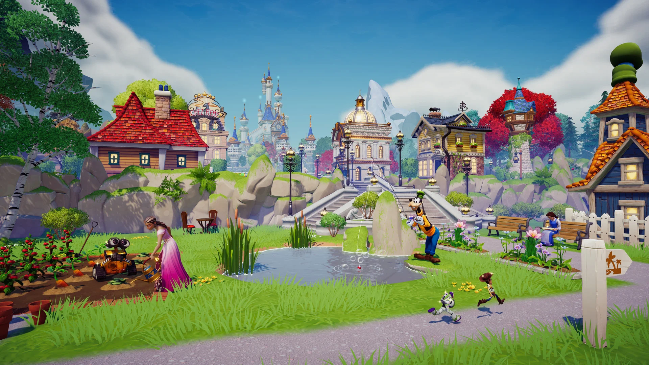
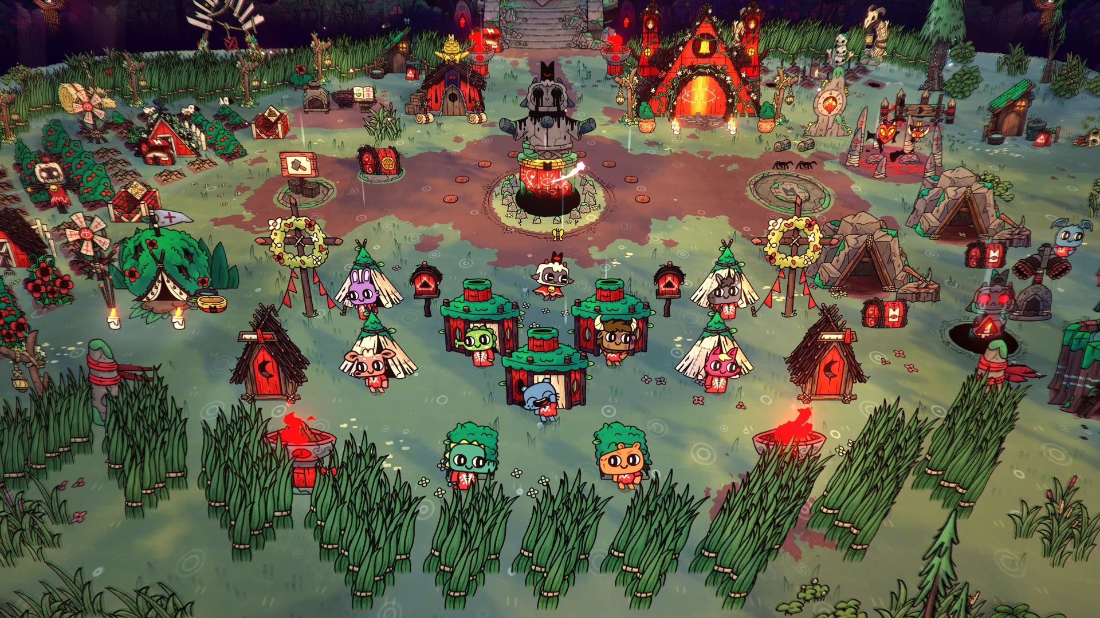
Cult of the Lamb
Disney Dreamlight Valley
…

Slide 14
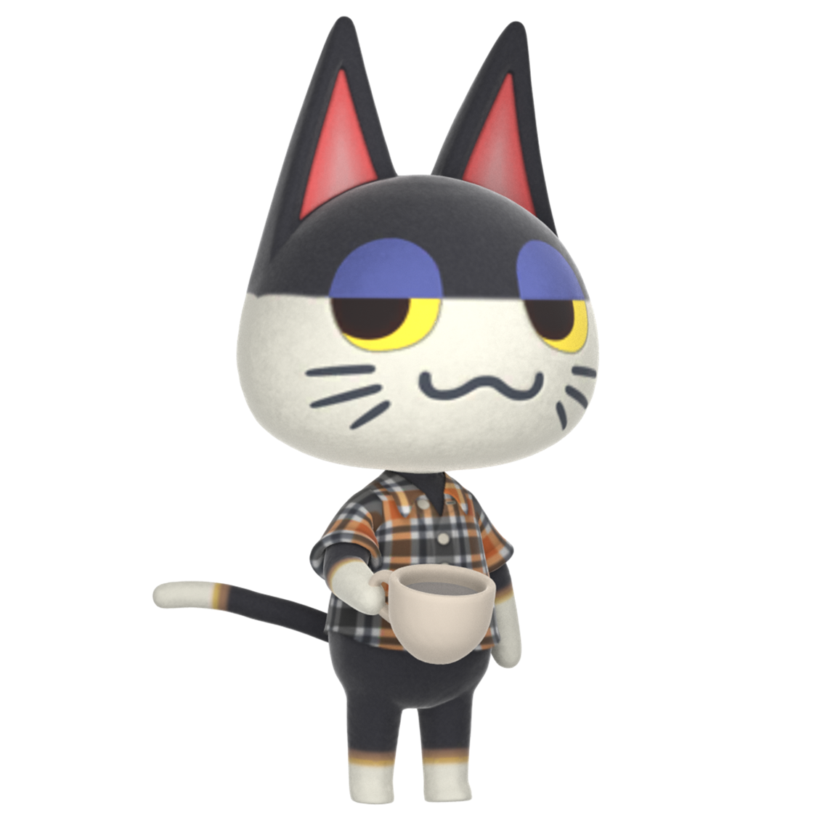
Part #6
How to improve?
Notes:
Next: if I was creating the next Animal Crossing game, what would I do differently?
Firstly, I would want to see a more unique and further stylized art style. New Horizons looks amazing for the hardware that it is on, but I would want to see them create something more daring, like with the first game. Maybe mix in some 2D and 3D assets, like in the cult of lamb.
Secondly, the game should have more things to do. In my opinion the biggest problem with the latest game was the lack of depth in the things you could do. Collecting things was fun yes, but making the process of catching fish and bugs would liven up the completion process, that is becoming larger and larger with each game bringing more things to collect. I would like to see a more enticing fishing mechanic, like the one in stardew valley.
This would make the things more interesting to do, while not having to create a whole bunch of new activities. This would also refresh the veteran players, while keeping the main gameplay loop familiar enough with what they already know.
Lastly, I would want to see the game have more distinction between the personailties. In the original game the cranky villagers would genuinely get angry at you for messing something up, while in the new game, since the characters are less exaggerated, they end up mixing with one another more. The distinction between the character personalitites was one of the main points of what I felt makes the games special and so successful.

Slide 15



New, experimental art style
More depth in the activities
Further distinct villager personalities
Notes:
Next: if I was creating the next Animal Crossing game, what would I do differently?
Firstly, I would want to see a more unique and further stylized art style. New Horizons looks amazing for the hardware that it is on, but I would want to see them create something more daring, like with the first game. Maybe mix in some 2D and 3D assets, like in the cult of lamb.
Secondly, the game should have more things to do. In my opinion the biggest problem with the latest game was the lack of depth in the things you could do. Collecting things was fun yes, but making the process of catching fish and bugs would liven up the completion process, that is becoming larger and larger with each game bringing more things to collect. I would like to see a more enticing fishing mechanic, like the one in stardew valley.
This would make the things more interesting to do, while not having to create a whole bunch of new activities. This would also refresh the veteran players, while keeping the main gameplay loop familiar enough with what they already know.
Lastly, I would want to see the game have more distinction between the personailties. In the original game the cranky villagers would genuinely get angry at you for messing something up, while in the new game, since the characters are less exaggerated, they end up mixing with one another more. The distinction between the character personalitites was one of the main points of what I felt makes the games special and so successful.

Slide 16
Thank You
Saku
Notes:
Thank you

Slide 17
Sources
Animal Crossing n.d. March Fishing Guide: New Fish, Leaving Fish, Complete List. https://animalcrossingworld.com/guides/new-leaf-welcome-amiibo/march-fishing-guide-new-fish-leaving-fish-complete-list/
BeardBear. 24.12.2020. Evolution of Christmas Toy Day in Animal Crossing (2001-2021). https://www.youtube.com/watch?v=ruip336qrio
BleuYon. 2018. Hey Katsuya Eguchi so how about that new game. https://www.reddit.com/r/AnimalCrossing/comments/b9gqr4/hey_katsuya_eguchi_so_how_about_that_new_game/
Clement. J. 15.3.2024. Unit sales of the Animal Crossing franchise worldwide as of March 2024, by title. https://www.statista.com/statistics/1112638/animal-crossing-unit-sales/
EBABYZ. 2.2.2017. The Sims 1: Gameplay (No Commentary) https://www.youtube.com/watch?v=gi0AB5ksxuY
Foredoomer. 9.5.2024. Animal Crossing New Leaf Part 36 Full Game - Longplay Walkthrough No Commentary. https://www.youtube.com/watch?v=BXg6a-Me9Tk
Free Emulator. 20.1.2022. Animal Crossing: City Folk (4K / 2160p / 60fps) | Dolphin Emulator 5.0-15837 | Nintendo Wii. https://www.youtube.com/watch?v=VtvtwCdp2NI
James Saunders. 20.4.2017. Rules and goals in game compositions. https://www.james-saunders.com/rules-and-goals-in-game-compositions/
Japancommercials4U2. 9.9.2021. Animal Crossing: Wild World Playthrough Part 2. https://www.youtube.com/watch?v=p7gR7Wry3Kg
Japancommercials4U2. 4.10.2022. Animal Crossing: City Folk Playthrough Part 12 (I Dig It!). https://www.youtube.com/watch?v=C4RVKv2iU7k
JkeGames. 11.12.2023. 100% Museum Tour in Animal Crossing: New Leaf!. https://www.youtube.com/watch?v=BODFx4MqCIg
JVGS, Jeff. 23.4.2019. Rest in Pete. https://www.jvgs.net/acwwblog/2019/04/23/rest-in-pete/
Kari-Pekka. 12.8.2022. Cult of the Lamb | Gameplay Walkthrough part 1 (Full game) - No commentary. https://www.youtube.com/watch?v=2da0u5sfO94
Ms,Bigglesworth. 25.7.2021. Nintendo Wii My Sims Kingdom Intro Gameplay No commentary. https://www.youtube.com/watch?v=66V98iTbQ3w
National Videogame Museum. n.d. Animal Crossing Diaries. https://animalcrossingdiaries.thenvm.org/context-history/
Nookipedia. n.d. Villager. https://nookipedia.com/wiki/Villager
PromptedLoki. 16.2.2021. Animal Crossing Part 200 No Commentary. https://www.youtube.com/watch?v=E3ZsKUvPyYQ
PromptedLoki. 12.9.2024a. Animal Crossing Part 411 No Commentary. https://www.youtube.com/watch?v=01Co7BeS_MY
PromptedLoki. 30.10.2024b. Animal Crossing Part 419 No Commentary https://www.youtube.com/watch?v=gOQoePnvsDg
Marvin Gichuru. 12.8.2019. Stardew Valley Walkthrough Gameplay E02 Fishing No Commentary. https://www.youtube.com/watch?v=KDA5gZ_mHww
Switch Playthroughs. 25.3.2020. Animal Crossing: New Horizons part 3 no commentary. https://www.youtube.com/watch?v=B5-1TMx9bAY
Tom nook aka the dept man. 4.4.2020. Tom nook says “pay your taxes” . https://aminoapps.com/c/animal-crossing/page/blog/tom-nook-says-pay-your-taxes/kVXp_P5tGup8YKd4EDJaDJW7Wngmm1Z3Wx
Notes:
Sources, including the video materials used for the presentation video.

